Slide 1
Python I
MASTER IN DATA MANAGEMENT AND CURATION · 2026–27
Python as a working tool for research data
load → clean → analyze → visualize → train
Matteo Biagetti
Area Science Park
13–16 October 2026
SISSA, Trieste · 18 hours
Notes:
Core module of the coursework, 18 hours in four days. The line in orange is the thread of the course: data goes in raw and comes out as a trained model, and every step is code.

Slide 2
Why this module
From raw data to a trained model, code is the central tool.
01
02
03
Curation is done in code
The common language of the coursework
Your internship project
Checking, cleaning, transforming and documenting data are steps you write, run and can show to others.
A FAIR-by-design data pipeline: from data collection to a documented dataset that others can reuse.
Python II, Python for Data Management, Machine Learning, Deep Learning and Applied AI all build on this week.
Python I · MDMC 2026–27
2 / 9
Notes:
The aim is practical competence: Python as a tool you use on research data, not Python as a subject. The three reasons: curation work is code; the rest of the coursework assumes it; and the internship project is itself a data pipeline. The phrase "read, rerun and trust" is from the module description: reproducibility is the FAIR idea applied to your own analysis.

Slide 3
Python in landmark research
2015 · LIGO
2019 · Event Horizon Telescope
2021 · AlphaFold
First detection of gravitational waves
First image of a black hole
Protein structures from their sequence
The signal GW150914 came from two merging black holes. PyCBC, one of the two searches that found it, is written mainly in Python.
Eight radio telescopes, over 350 TB of data a day. Processed with NumPy, SciPy, pandas and Astropy; the image was drawn with Matplotlib.
A neural network that predicts the 3D structure of a protein from its amino-acid sequence. Its open-source code is Python, built on JAX.
Reproduced in 2021
Reproduced in 2022
Nobel Prize in Chemistry 2024
Brown et al., Comput. Sci. Eng. 23(2), 73 (2021)
numpy.org case study; Patel et al., Comput. Sci. Eng. 24(5), 42 (2022)
Jumper et al., Nature 596, 583 (2021)
Two of the three were checked by independent teams because the code and the data were public: FAIR in practice.
Python I · MDMC 2026–27
3 / 9
Notes:
Three well-documented results that ran on the same open-source stack as this course. GW150914 (2015): PyCBC, one of the two matched-filter searches, is written mainly in Python; Brown et al. (2021) reproduced the main result from the public code and data. M87* (2019): the NumPy case study lists NumPy, SciPy, pandas, Astropy, eht-imaging and Matplotlib in the pipeline; Patel et al. (2022) rebuilt the workflow from public artifacts with Jupyter notebooks and Docker containers. AlphaFold (2021): open-source code in Python with JAX; half of the 2024 Nobel Prize in Chemistry went to Hassabis and Jumper. The point for this master: these results could be checked by others because code and data were public.

Slide 4
By Friday 16 October you will be able to
LEARNING OUTCOMES
01
Write and structure Python code for practical data handling tasks
02
Load, clean, transform and visualize research data reproducibly
03
Build, train and evaluate a simple neural network model end to end
Python I · MDMC 2026–27
4 / 9
Notes:
These are the three learning outcomes as published on the module page. The first two are what the rest of the master uses every day; the third is the bridge to Introduction to ML, Introduction to Deep Learning and Applied AI.

Slide 5
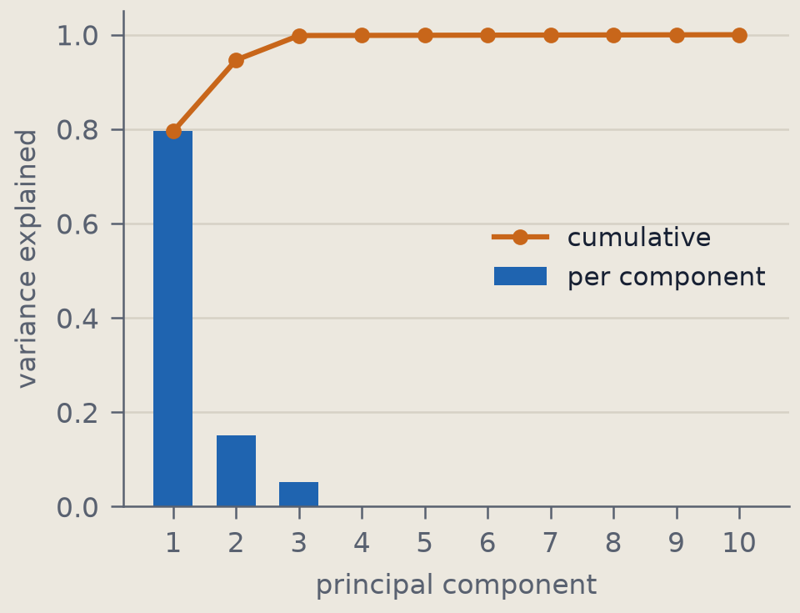
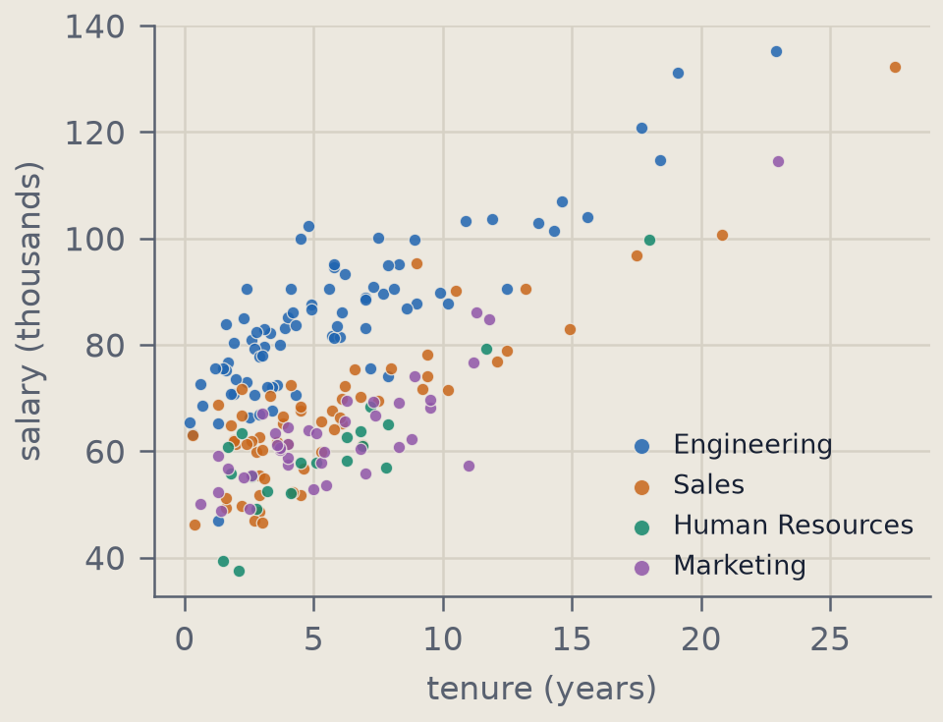
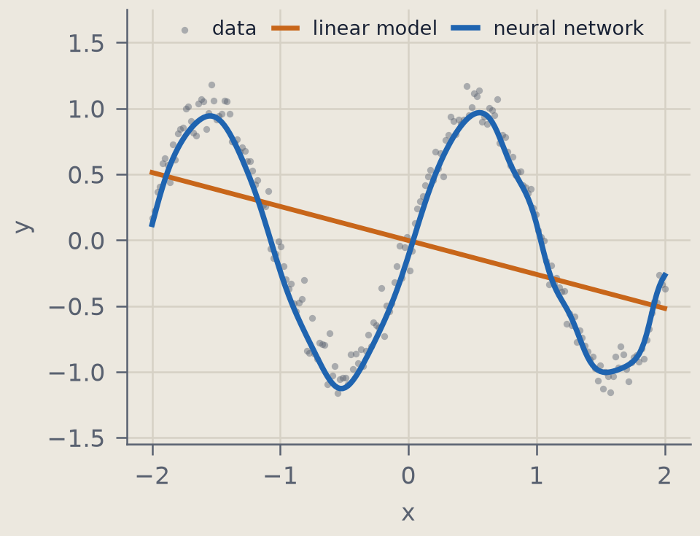
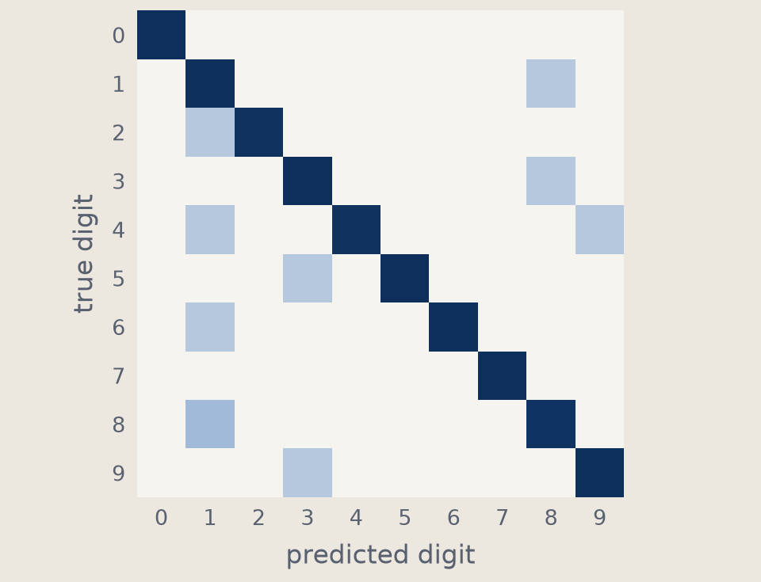
What you will make this week
notebook 01 · NumPy
notebook 03 · pandas
notebook 06 · PyTorch
notebook 09 · PyTorch
PCA by hand
Explore a dataset
A first network
Classify digits
A 10-dimensional point cloud: three components carry 99.8% of the variance.
200 employees: salary grows with tenure (r = 0.70) and differs by department.
1,153 parameters fit a curve that no straight line can.
97% accuracy on unseen test images, against 93% for a linear model.
Python I · MDMC 2026–27
5 / 9
Notes:
Four outputs of the course notebooks, re-run for this slide with the course code: PCA by hand on a 10-dimensional Gaussian cloud with three intrinsic directions (cumulative explained variance 99.8% at three components); the 200-employee company dataset (correlation between salary and tenure 0.70); a 1,153-parameter MLP fitting a sine curve against a linear model; the digits classifier of notebook 09 (test accuracy 97.2% plus or minus 0.9%, linear model 93.3%, majority class 10%), shown as its confusion matrix.

Slide 6
Where Python I sits in the coursework
Sep
Oct
Nov
Dec
Scientific Programming Environment
Sep 23–30
Scientific Programming Methods
Sep 29 – Oct 9
Python I
Oct 13–16
Python II
Oct 19–23
Introduction to DataBase
Oct 26 – Nov 13
Python for Data Management I
Oct 26 – Nov 6
Introduction to ML
Nov 9–12
Python for Data Management II
Nov 16–24
Introduction to Deep Learning
Nov 24–26
Applied AI
Dec 2–11
Foundations
This module
Software and data
Learning from data
Bars mark teaching days.
Python I · MDMC 2026–27
6 / 9
Notes:
Programming, data and AI modules of the coursework, from the 2026–27 lessons calendar; bars are teaching days. Python I comes right after the two foundation modules on Unix and Git, and opens the sequence of modules that use Python: Python II the following week, the Data Management and database modules, then Machine Learning, Deep Learning and Applied AI towards December. FAIR, open science, data stewardship, legal and security modules run in parallel and are not shown.

Slide 7
What we cover, and what comes before and after
Before
This week
Unix shell and scripting | Scientific Programming Environment
Git, documentation, FAIR software | Scientific Programming Methods
Python essentials and the scientific ecosystem
NumPy for numerical data
pandas for tabular data: load, clean, merge, aggregate
Files and sources: CSV, JSON, SQLite, a web data service
Plots with Matplotlib and Seaborn
PyTorch: tensors, autograd, training loops, a first neural network
After
Classes, tests, packaging, REST APIs | Python II
Databases | Introduction to DataBase
Pipelines, GitHub, web back ends | Python for Data Management I
Vector search, RAG, model serving | Python for Data Management II
Machine learning methods | Introduction to ML
Architectures, training, diagnostics | Introduction to Deep Learning
Curation projects, AI-assisted coding | Applied AI
Python I · MDMC 2026–27
7 / 9
Notes:
Python I is deliberately narrow: the tools to get data in, clean it, look at it and fit a model to it. Topics that other modules treat properly are only touched here: object-oriented design, testing, packaging and web APIs in Python II; pipelines and collaboration in Python for Data Management; databases in Introduction to DataBase; the theory of learning and of network architectures in Introduction to ML and Introduction to Deep Learning. We assume the shell and Git from the two foundation modules.

Slide 8
Schedule: four days, nine blocks of two hours
Tue 13 Oct
Wed 14 Oct
Thu 15 Oct
Fri 16 Oct
Room 003
Room 005
Room 003
Room 005
Setup, Python warm-up, files
pandas: loading and cleaning data
Visualization: Matplotlib, Seaborn
DataLoaders and mini-batches
notebook 01
notebook 02
notebook 07–08
09:00 – 11:00
notebook 03
NumPy, and PCA by hand
pandas: groupby, merge, real data
PyTorch: tensors and autograd
Train and evaluate a network
11:15 – 13:15
notebook 01
notebook 02
notebook 05
notebook 09
First model: loss and optimizer
14:30 – 16:30
notebook 06
Working with data
Machine learning with PyTorch
Take-home: project on image and text data (notebook 04)
Python I · MDMC 2026–27
8 / 9
Notes:
All sessions are in the SISSA main building, rooms as in the official calendar. The first two days are about data: NumPy, pandas, files and plots. The last two days follow one machine-learning workflow from tensors to an evaluated network. The project exercise on CIFAR-10 images and newsgroup texts is meant for individual study after Wednesday; solutions follow.

Slide 9
How we will work
Laboratory format
Materials
Every block: a short introduction, then exercises in a Jupyter notebook.
One notebook per topic, with its data. Solutions are shared after each block.
Your setup
What we assume
Jupyter on your Linux laptop or the course VM; the packages are listed in requirements.txt.
Basic Python, as in the admission requirements, plus the shell and Git from the two foundation modules.
Questions: matteo.biagetti@areasciencepark.it
Tutor: Sven Heydenreich
Python I · MDMC 2026–27
9 / 9
Notes:
Practicalities. Each two-hour block mixes a short explanation with exercises; you type the code yourselves. Bring a working environment on the first morning: the first block starts with the setup.

